Slide 1
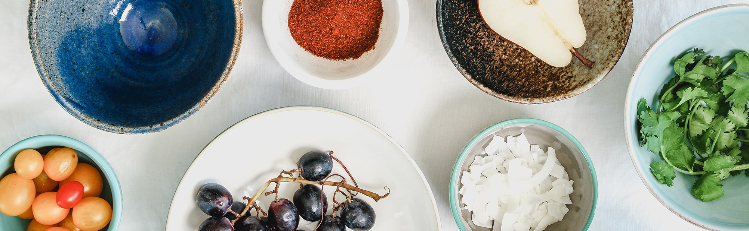
Healthy Recipes Insights
Prepared By
Prarthana Vengurlekar

Slide 2
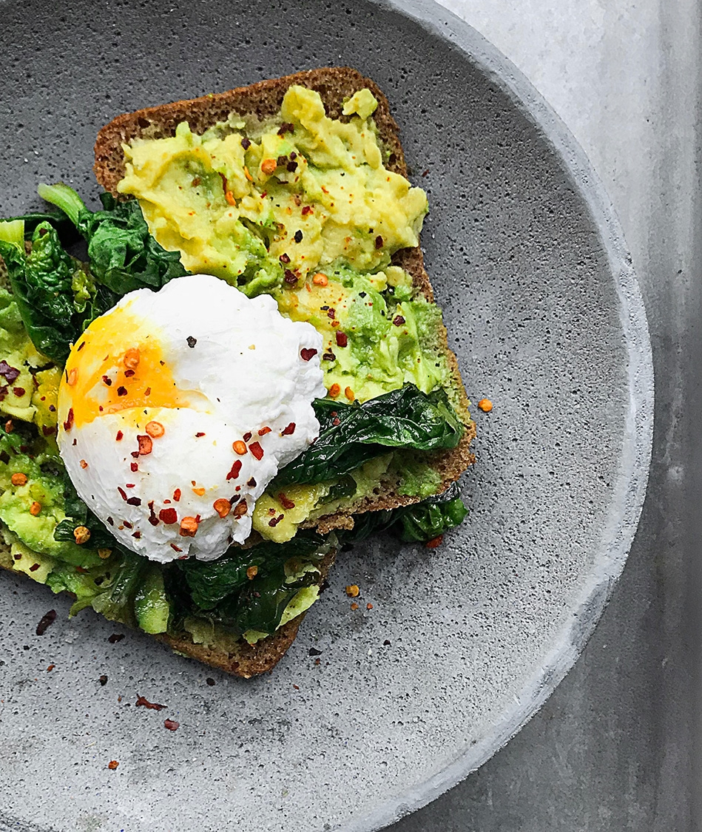
ABSTRACT
THE HEALTHY RECIPES INSIGHTS, FOR SHARING IS A RECIPE PORTAL THAT WILL HELP THE USER TO SEARCH VARIOUS HEALTHY RECIPES TRY THEM THAT CAN BE SWEET OR SAVOURY, AND CAN RATE THEM AND COMMENT ON THEM, THERE ARE VARIOUS TYPES OF DIETS THAT CAN HELP THE CUSTOMER TO LOOK ON THEIR HEALTH WITH THE EASE OF STORING AND USING THE RECIPIES.

Slide 3
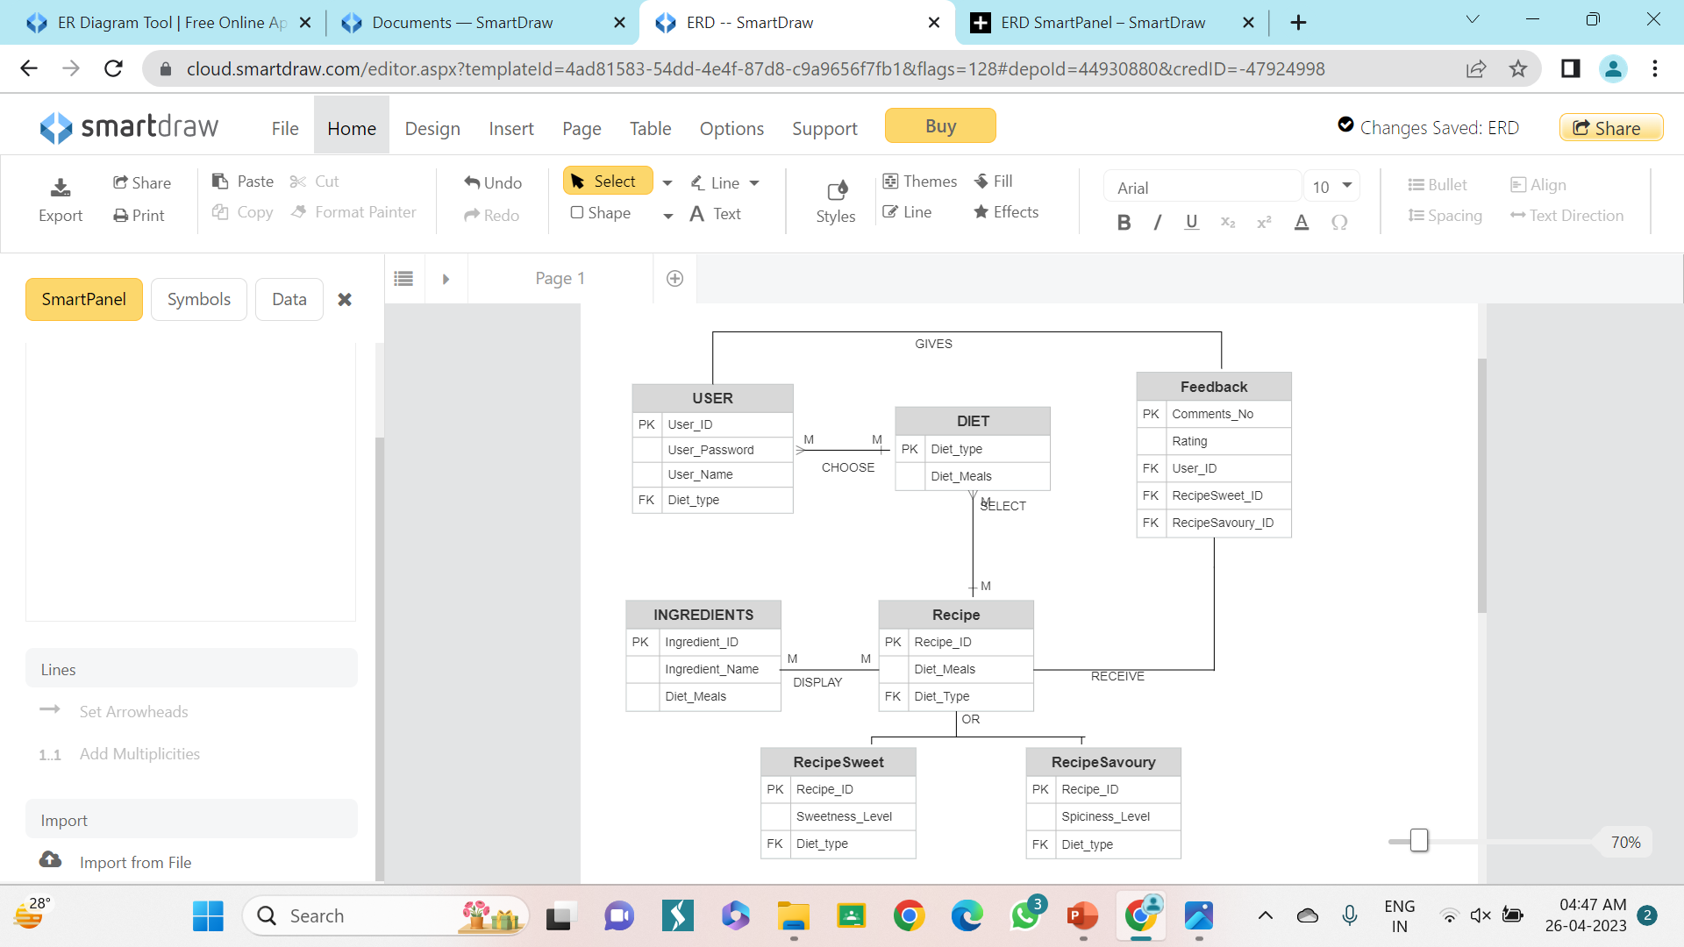
ER- DIAGRAM

Slide 4
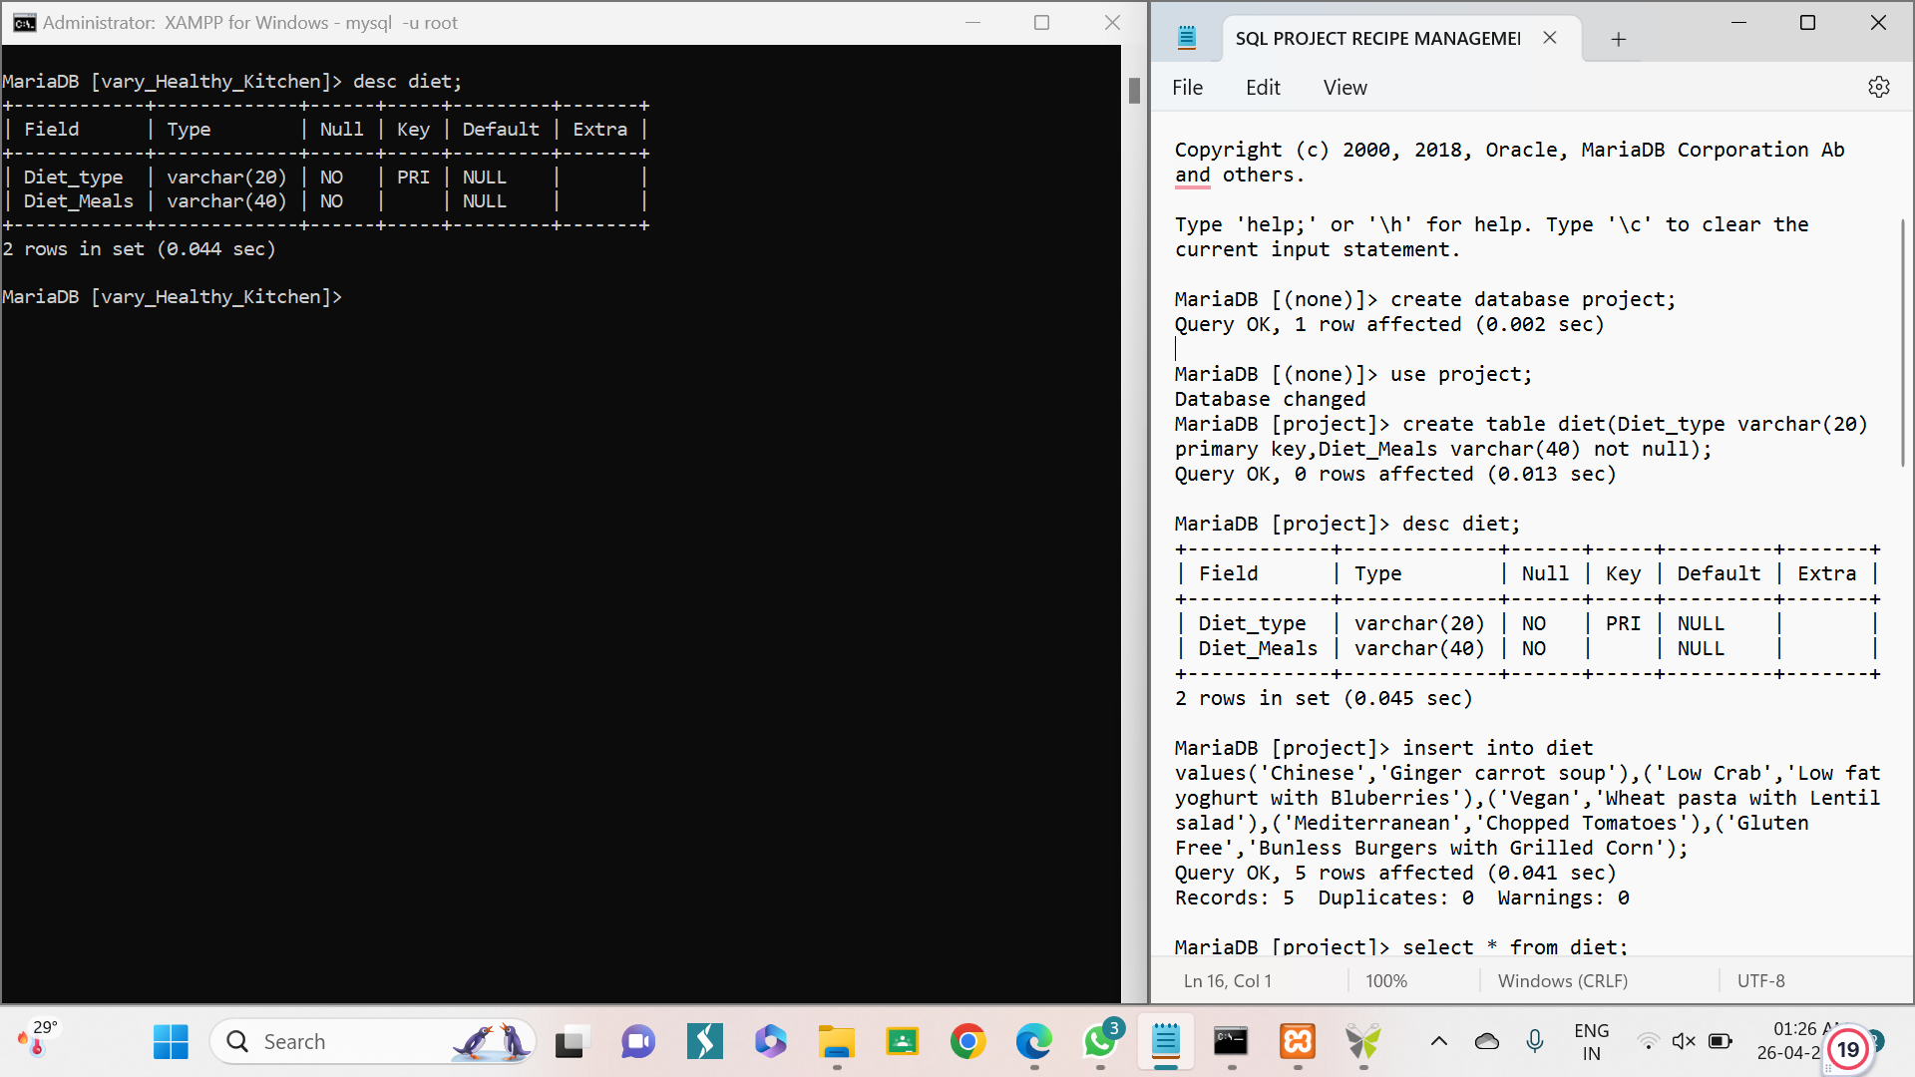
STRUCTURE OF TABLE
DIET TABLE
THIS TABLE SHOWS THE TYPES OF DIETS PRESENT AND THE MEALS IN PARTICULAR DIET TYPE
SYNTAX: DESC DIET;

Slide 5
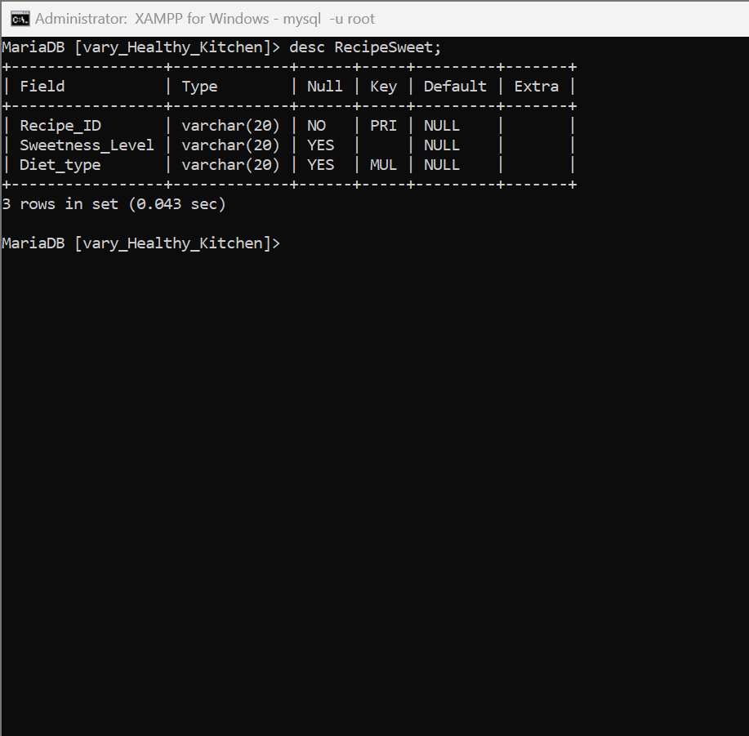
STRUCTURE OF TABLE
RECIPESWEET TABLE
THIS TABLE SHOWS THE DETAILS USCH AS RECIPE ID, SWEETNESS LEVEL AND DIET TYPE.
SYNTAX: desc RecipeSweet;

Slide 6
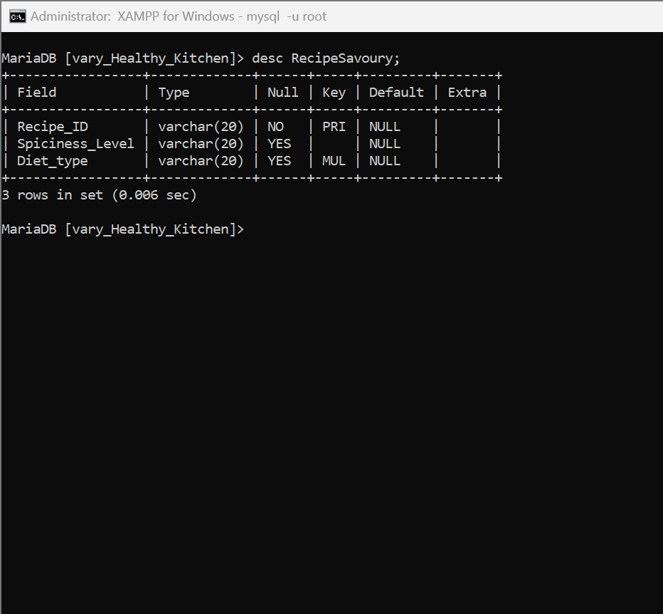
STRUCTURE OF TABLE
RECIPESAVOURY TABLE
THIS TABLE SHOWS THE DETAILS OF SUCH AS RECIPE ID, SPICINESS LEVEL, AND DIET TYPE.
SYNTAX: desc RecipeSavoury;

Slide 7
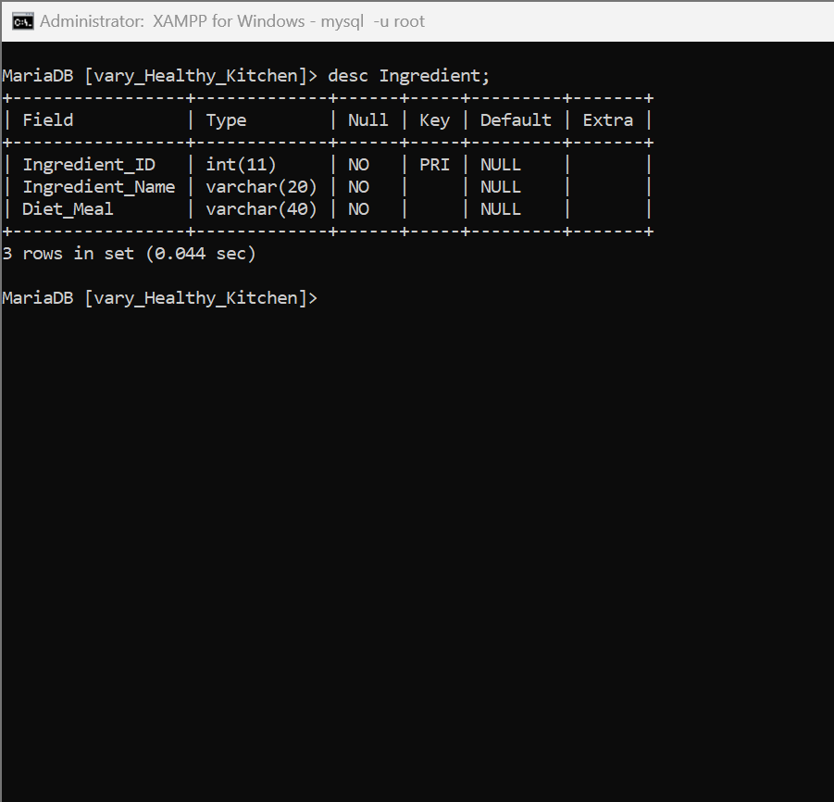
STRUCTURE OF TABLE
INGREDIENT TABLE
THIS TABLE SHOWS THE INGREDIENTS INGREDIENT ID, INGREDIENT NAME, AND DIET MEAL.
SYNTAX: DESC INGREDIENT;

Slide 8
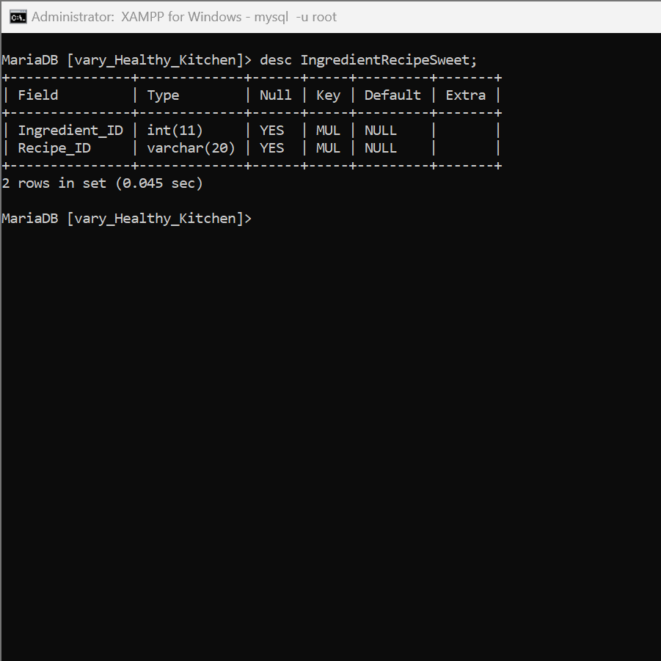
STRUCTURE OF TABLE
INGREDIENTRECIPESWEET TABLE
THIS TABLE SHOWS THE INGREDIENTS IN THE RECIPE FOR SWEETS AS INGREDIENT ID AND RECIPE ID
SYNTAX: DESC INGREDIENTRECIPESWEET;

Slide 9
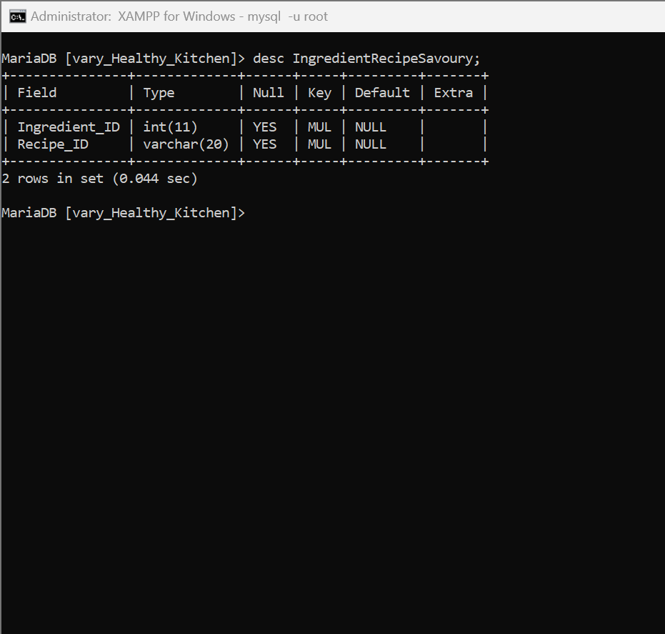
STRUCTURE OF TABLE
INGREDIENTRECIPESAVOURY TABLE
THIS TABLE SHOWS THE INGREDIENTS FOR SAVOURY RECIPES IT CONTAINS INGREDIENT ID AND RECIPE ID
SYNTAX: DESC INGREDIENTRECIPESAVOURY;

Slide 10
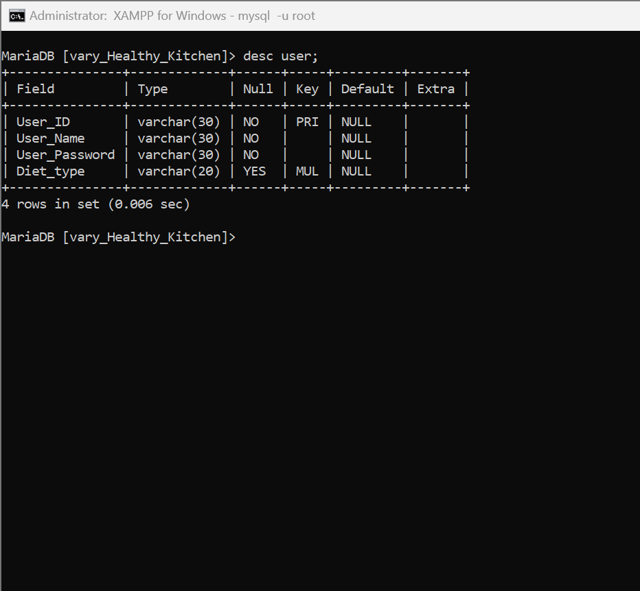
STRUCTURE OF TABLE
USER TABLE
THIS TABLE SHOWS THE USERS CONTAIN USER ID, USER NAME, USER PASSWORD, DIET TYPE
SYNTAX: DESC USER;

Slide 11
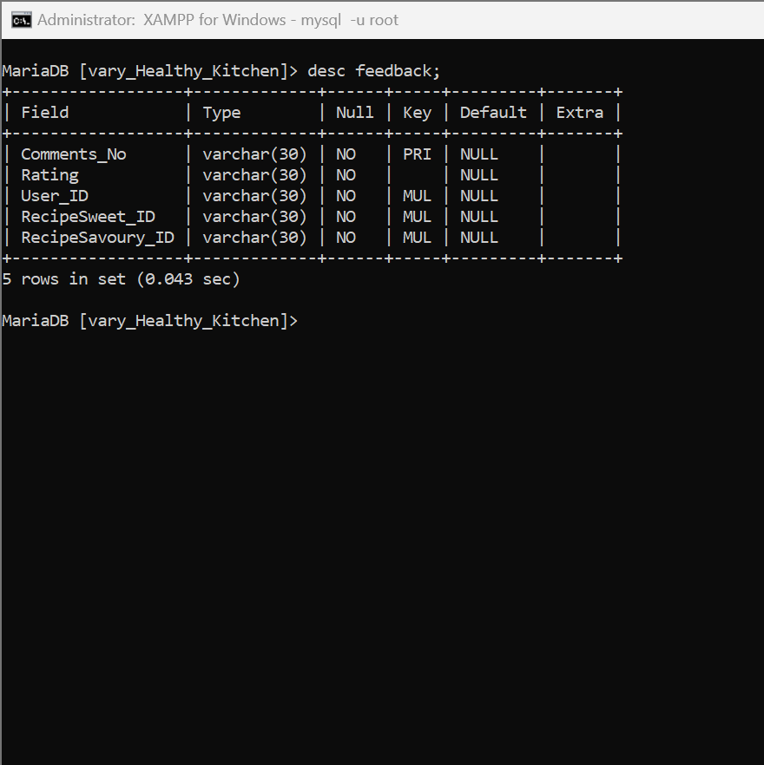
STRUCTURE OF TABLE
FEEDBACK TABLE
THIS TABLE SHOWS FEEDBACK CONTAINING COMMENT NO, RATING USER ID RECIPESWEET ID RECIPE SAVOURY ID
SYNTAX: DESC FEEDBACK;

Slide 12
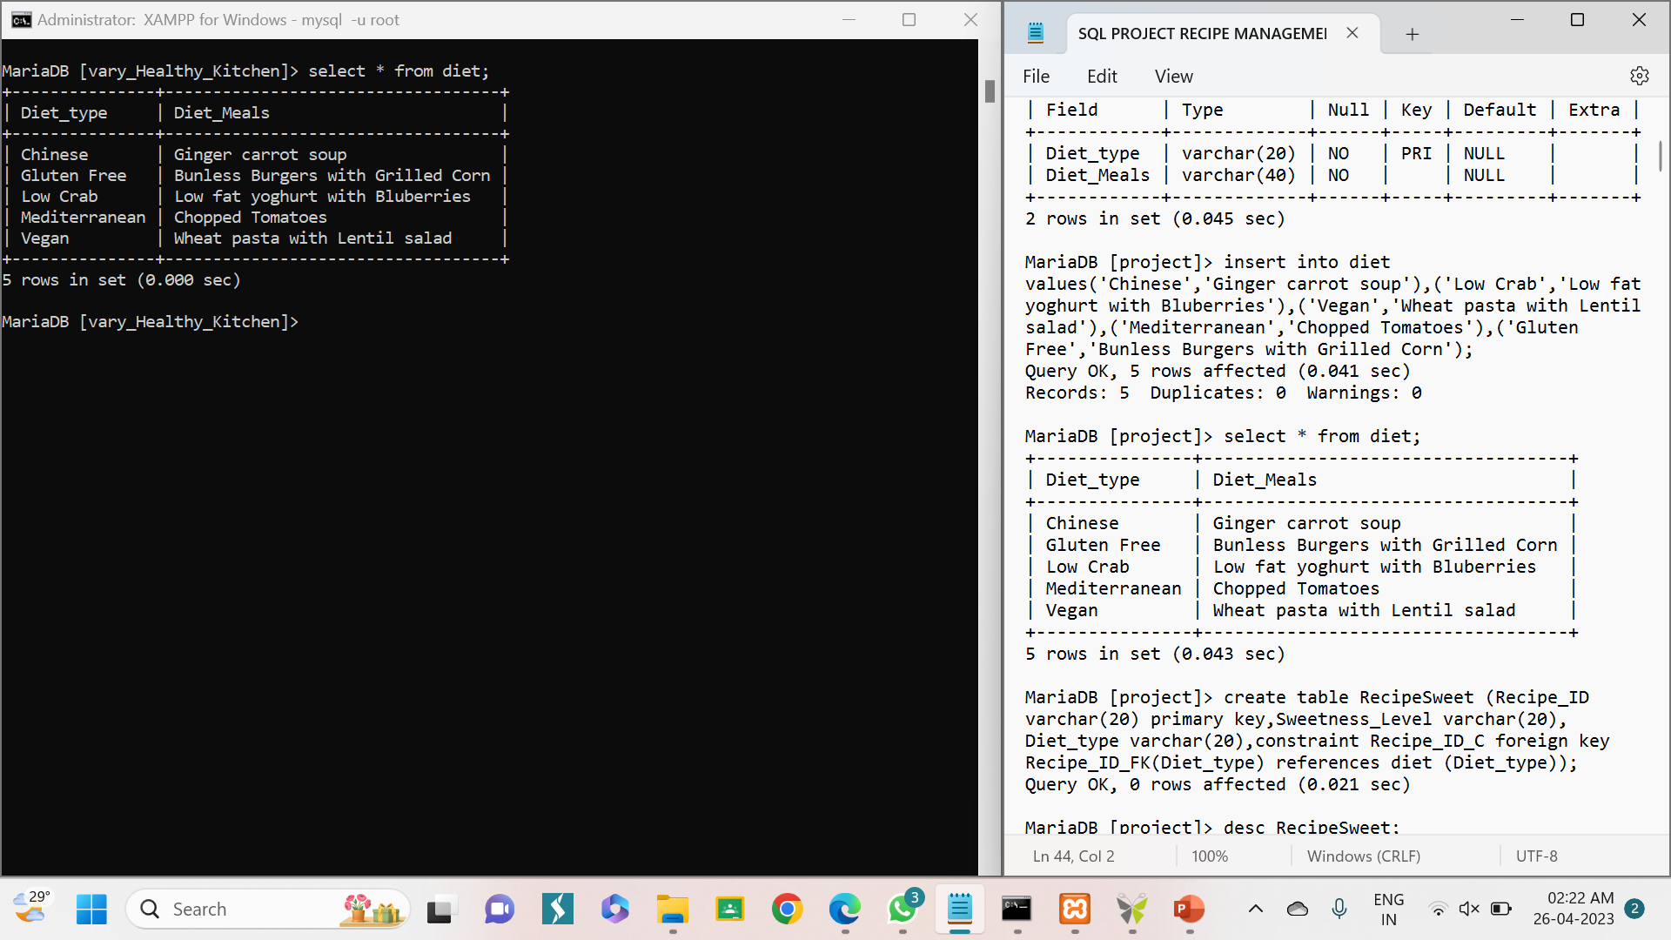
CONTENTS OF TABLE

Slide 13
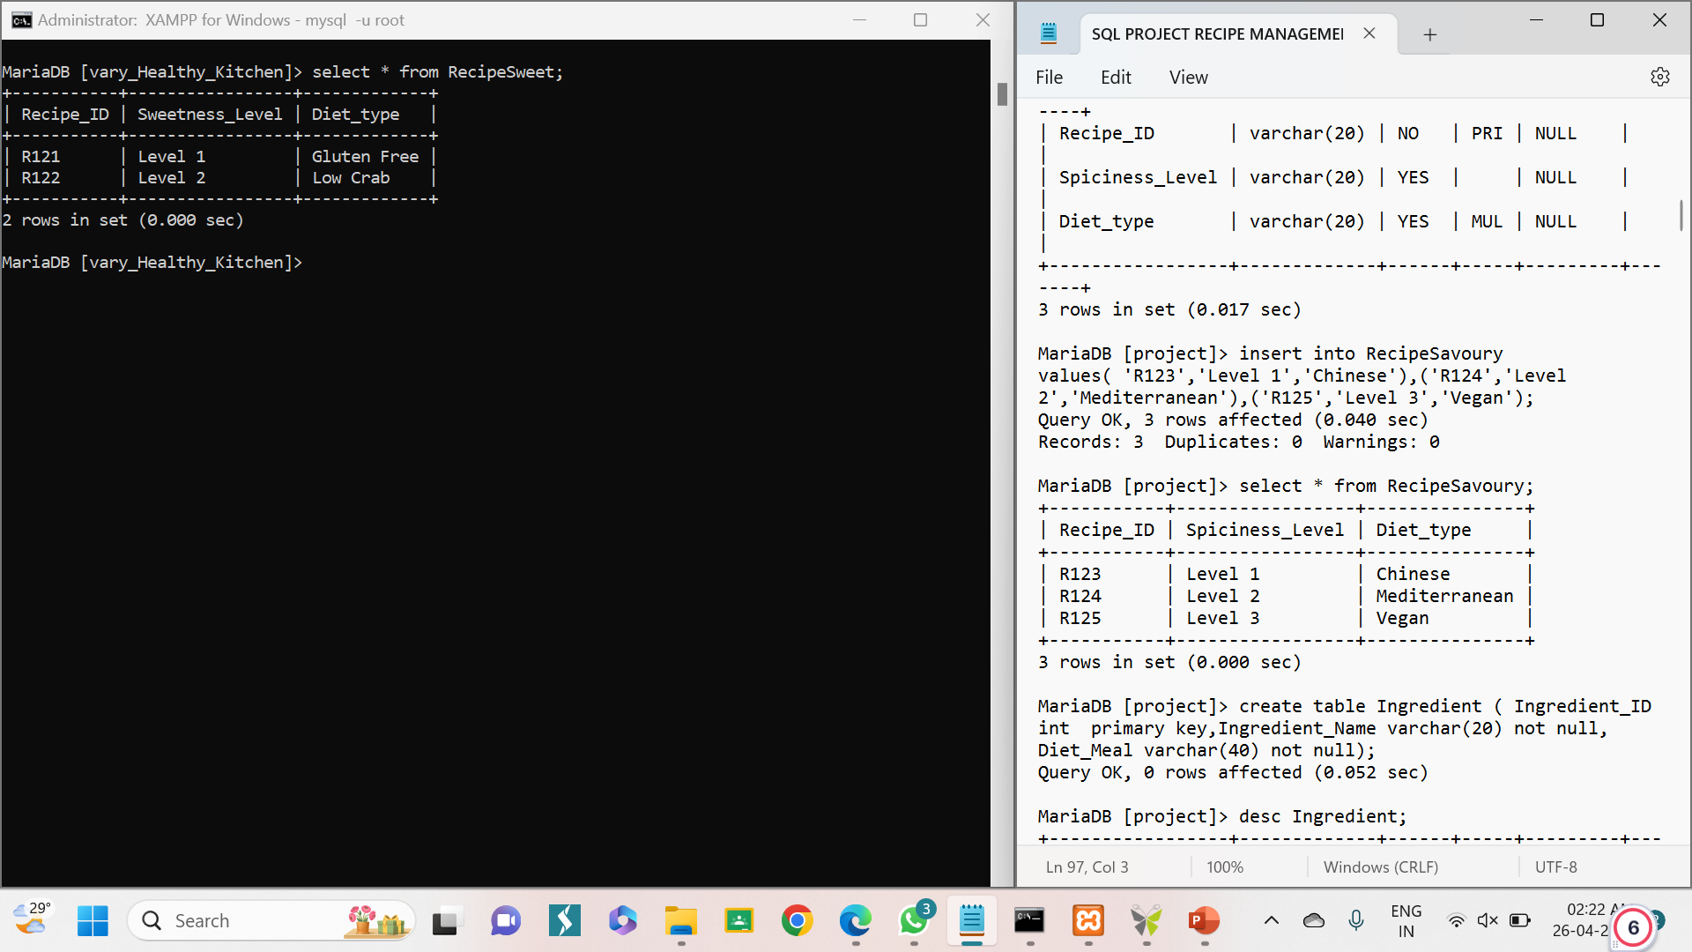
CONTENTS OF TABLE

Slide 14

CONTENTS OF TABLE

Slide 15
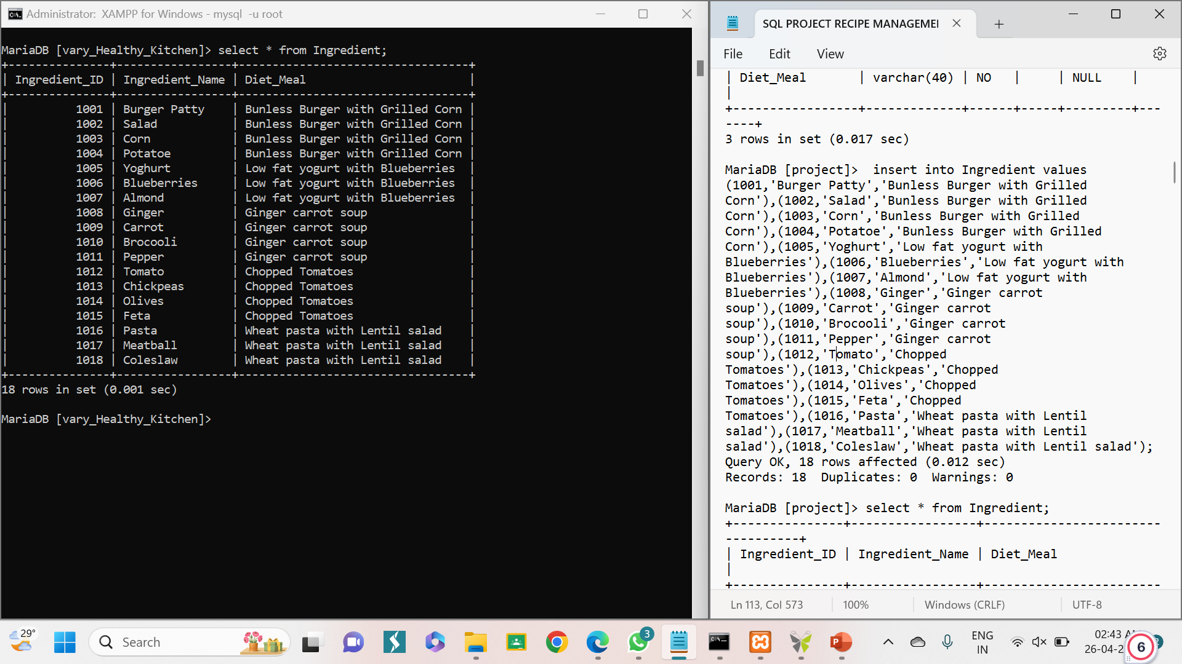
CONTENTS OF TABLE

Slide 16
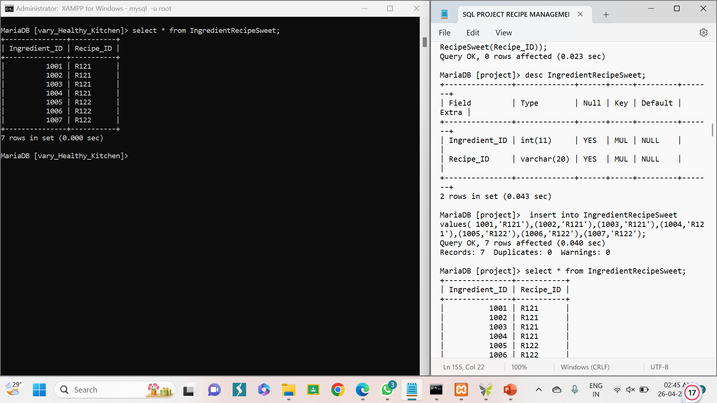
CONTENTS OF TABLE

Slide 17
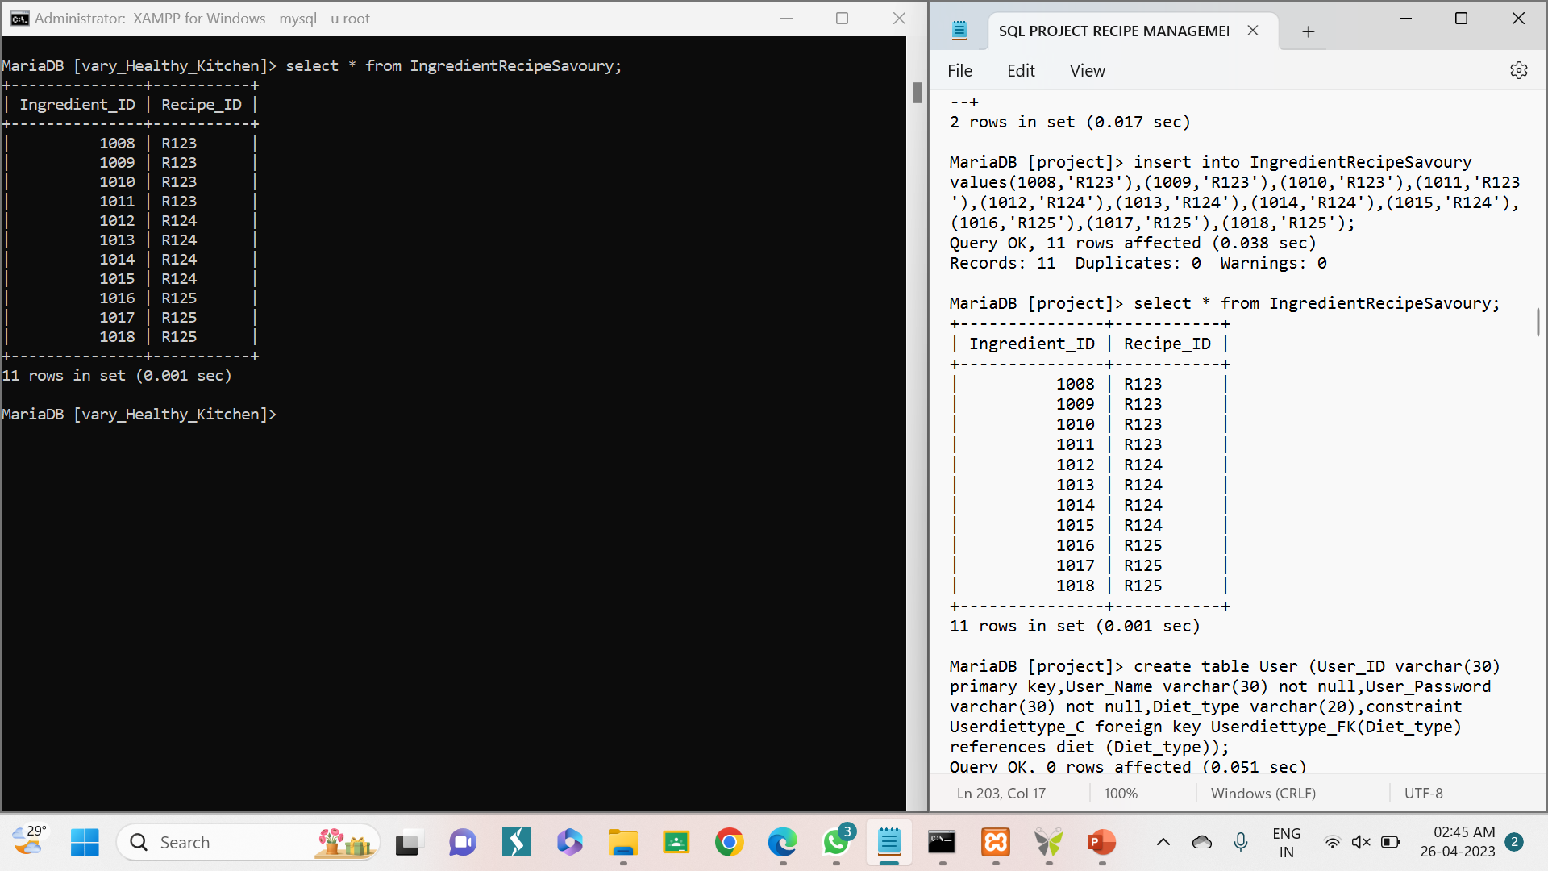
CONTENTS OF TABLE

Slide 18
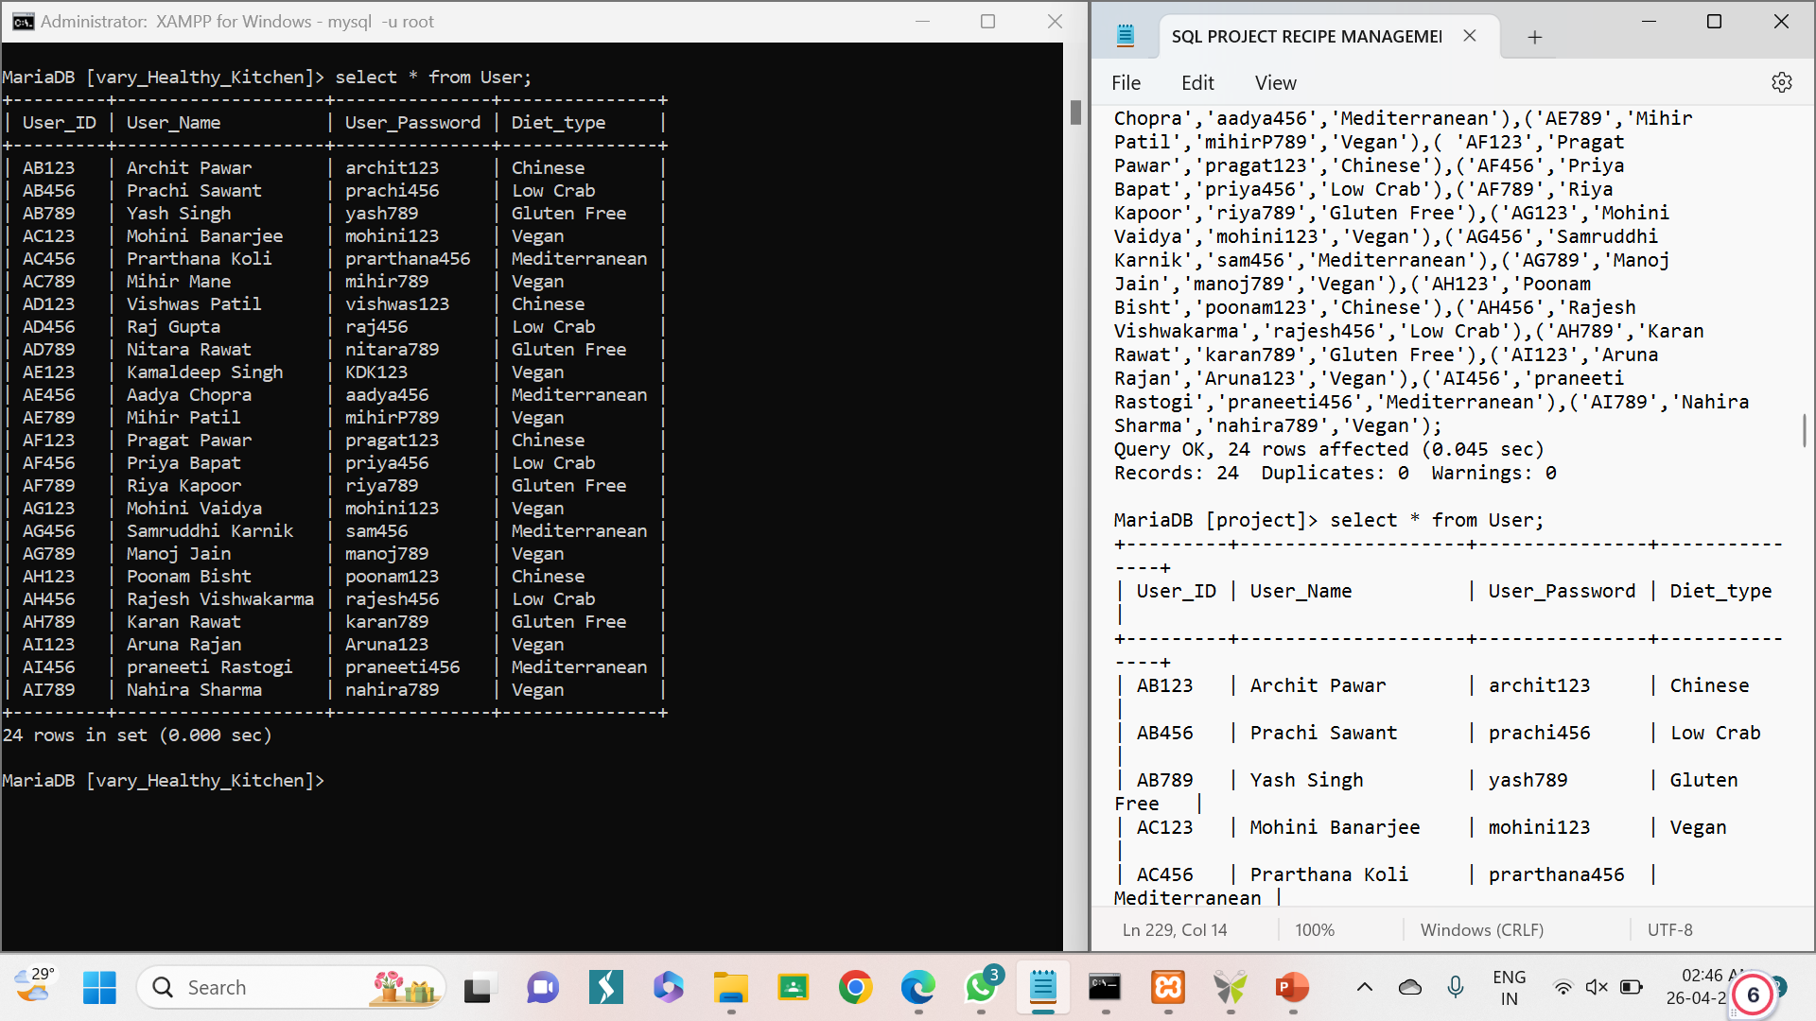
CONTENTS OF TABLE

Slide 19
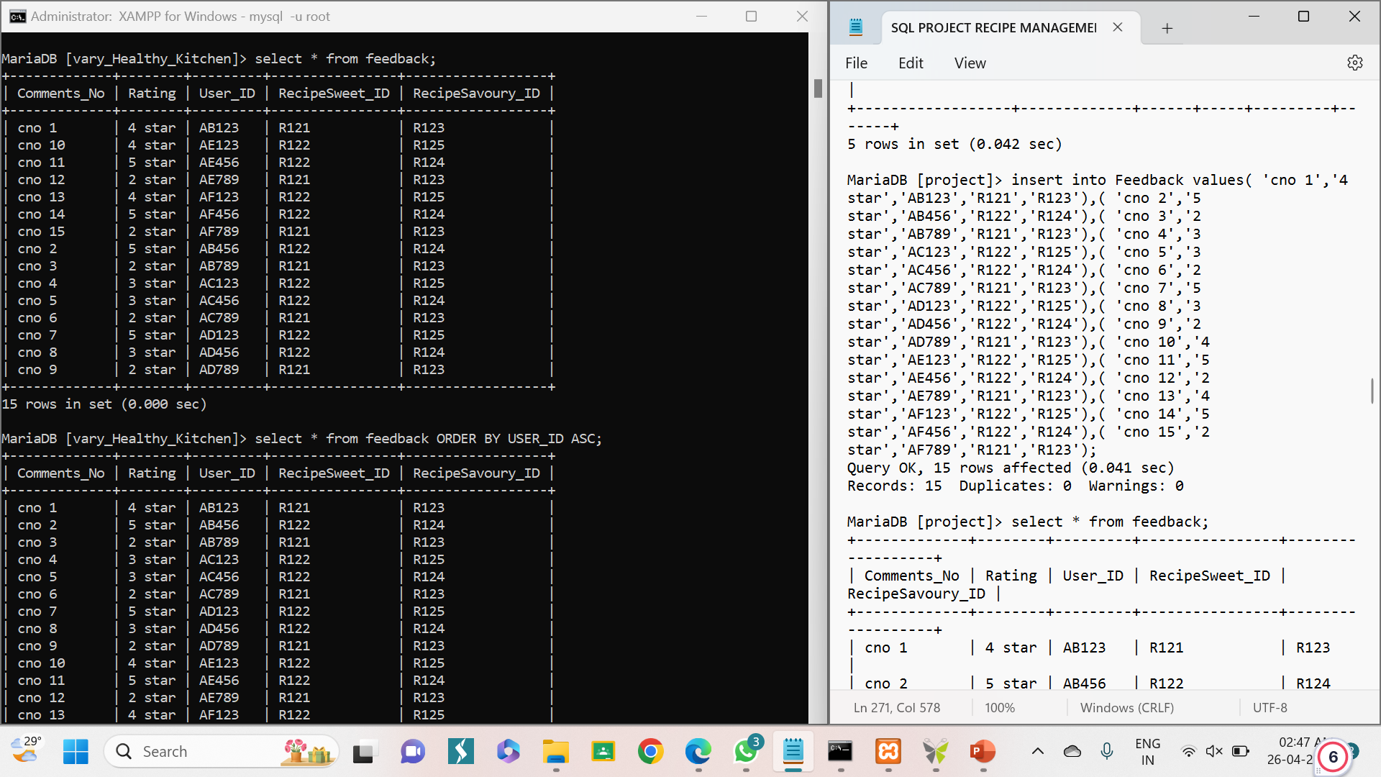
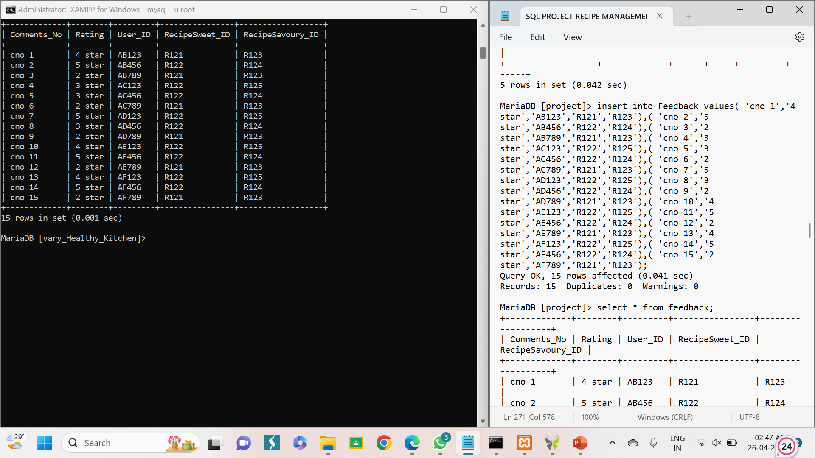
CONTENTS OF TABLE

Slide 20
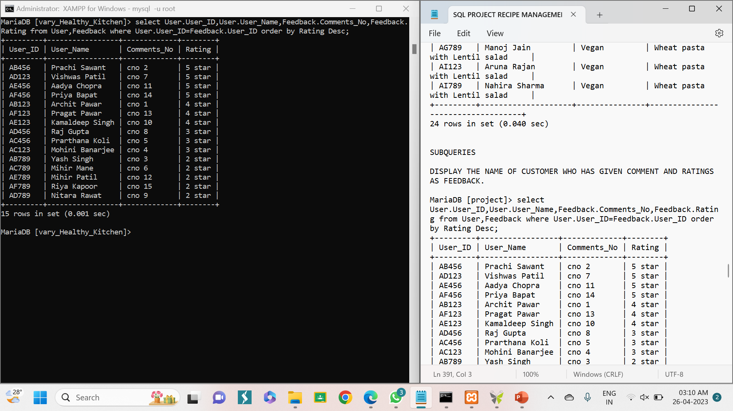
SUBQUERY
DISPLAY THE NAME OF CUSTOMER WHO HAS GIVEN COMMENT AND RATINGS AS FEEDBACK.
SYNTAX: select User.User_ID,User.User_Name,Feedback.Comments_No,Feedback.Rating from User,Feedback where User.User_ID=Feedback.User_ID order by Rating Desc;

Slide 21
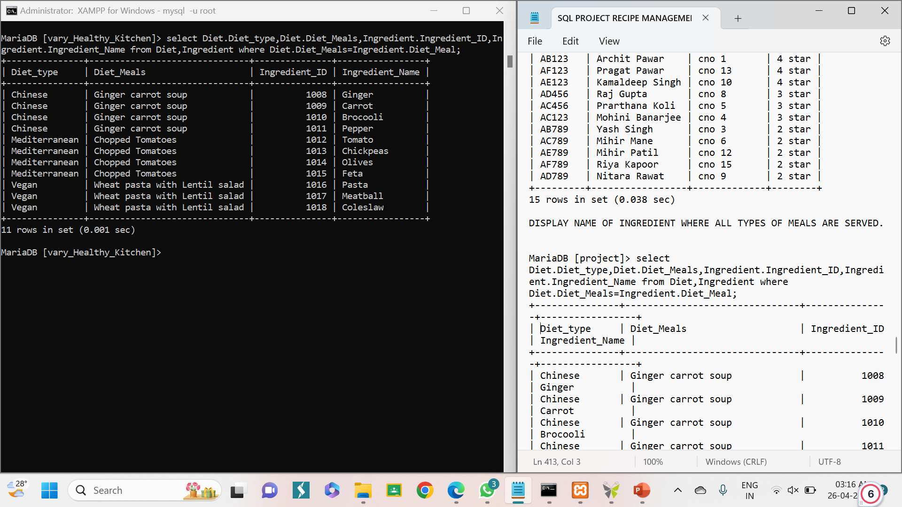
SUBQUERY
DISPLAY NAMES OF INGREDIENTS WHERE ALL TYPES OF MEALS ARE SERVED.
SYNTAX:select Diet.Diet_type,Diet.Diet_Meals,Ingredient. Ingredient_ID,Ingredient.Ingredient_Name from Diet,Ingredient where Diet.Diet_Meals=Ingredient.Diet_Meal;

Slide 22
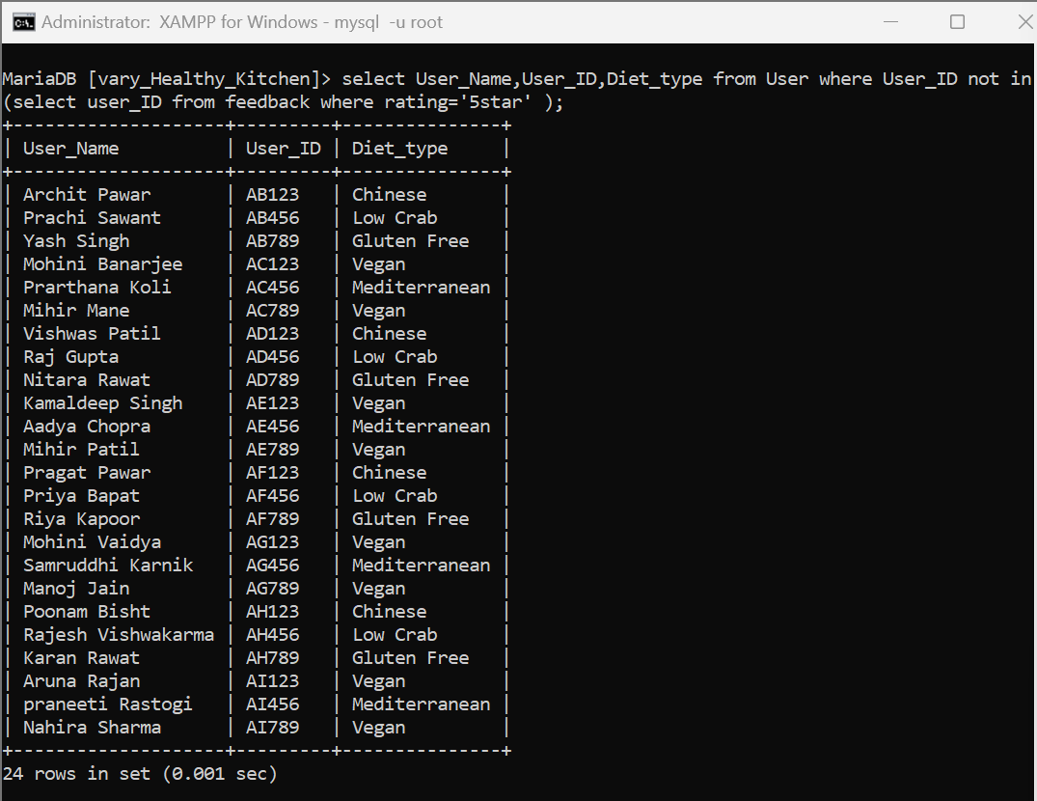
SUBQUERY
DISPLAY CUSTOMERS WHO HAVE NOT GIVEN 5 STAR RATING
SYNTAX: select User_Name,User_ID,Diet_type from User where User_ID not in(select user_ID from feedback where rating='5star' );

Slide 23
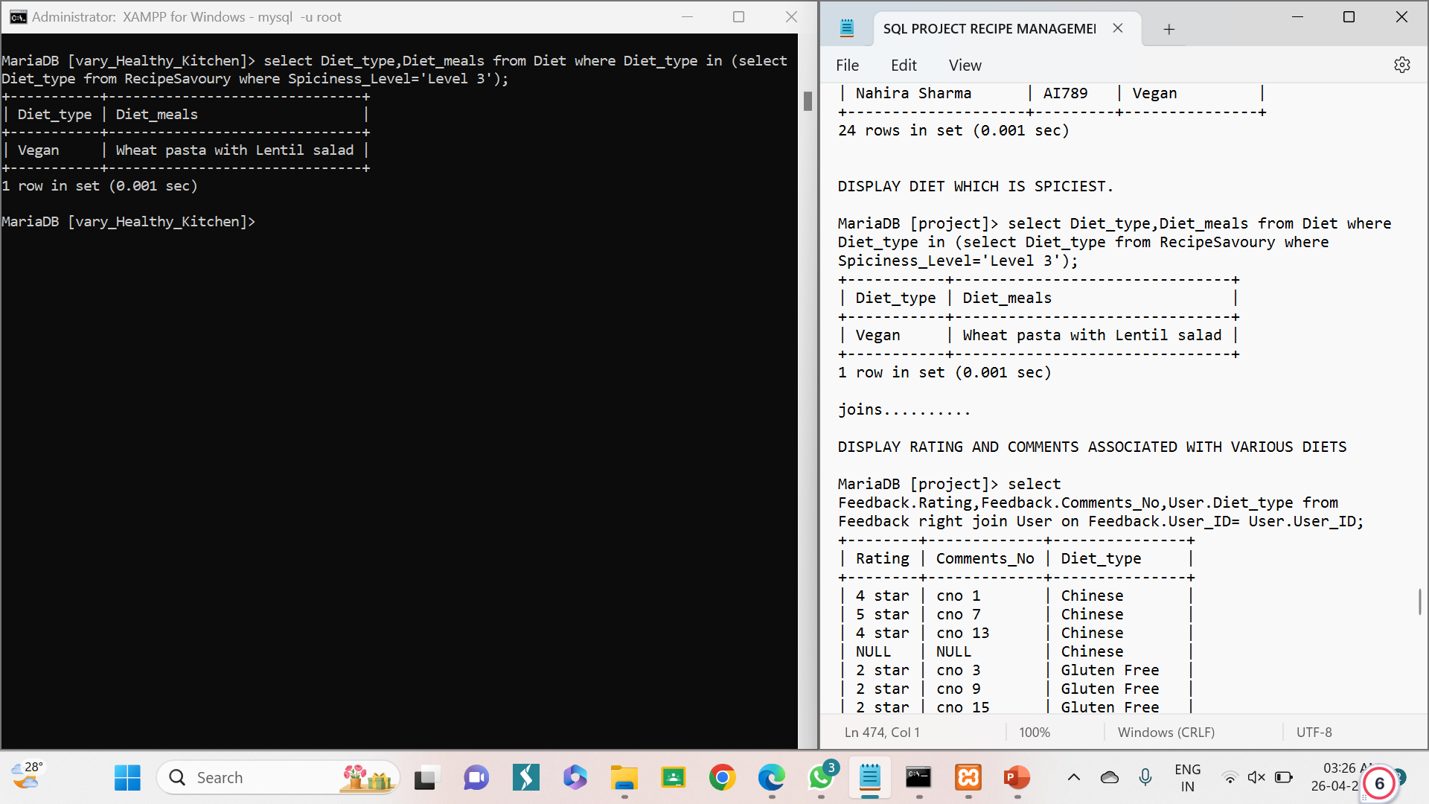
SUBQUERY
DISPLAY DIET WHICH IS SPICIEST.
SYNTAX: select Diet_type,Diet_meals from Diet where Diet_type in (select Diet_type from RecipeSavoury where Spiciness_Level='Level 3');

Slide 24
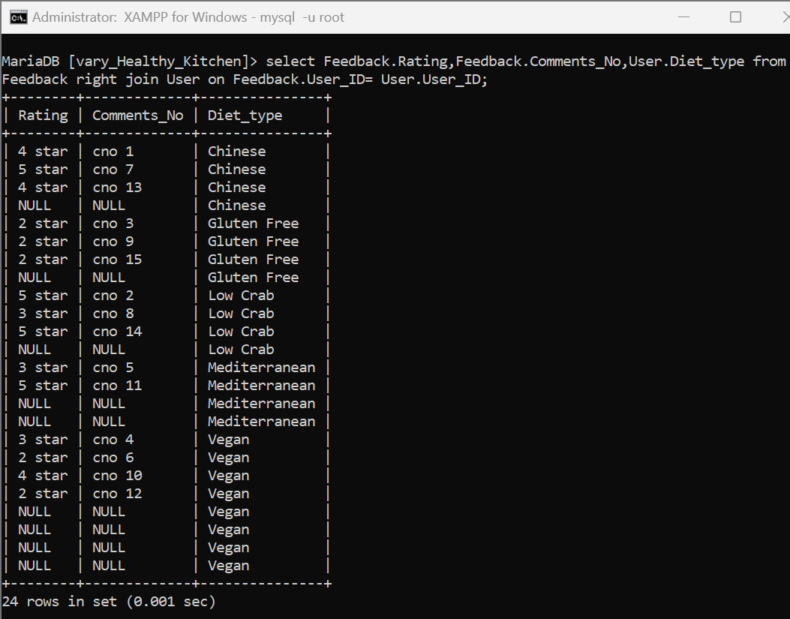
JOINS.
DISPLAY RATING AND COMMENTS ASSOCIATED WITH VARIOUS DIETS.
SYNTAX: select Feedback.Rating,Feedback.Comments_No,User.Diet_type from Feedback right join User on Feedback.User_ID= User.User_ID;

Slide 25
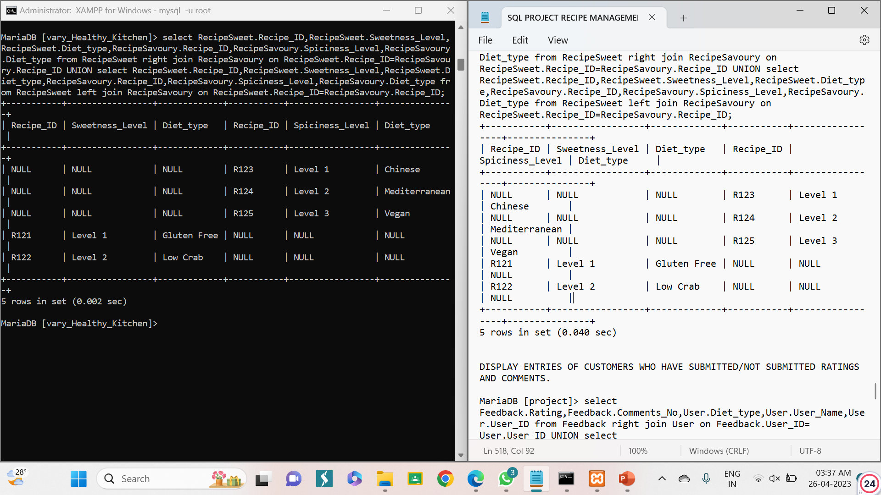
JOINS.
DISPLAY ALL THE SWEET AND SAVOURY RECIPES..
SYNTAX: select RecipeSweet.Recipe_ID,RecipeSweet.Sweetness_Level,RecipeSweet.Diet_type,RecipeSavoury.Recipe_ID,RecipeSavoury.Spiciness_Level,RecipeSavoury.Diet_type from RecipeSweet right join RecipeSavoury on RecipeSweet.Recipe_ID=RecipeSavoury.Recipe_ID UNION select RecipeSweet.Recipe_ID,RecipeSweet.Sweetness_Level,RecipeSweet.Diet_type,RecipeSavoury.Recipe_ID,RecipeSavoury.Spiciness_Level,RecipeSavoury.Diet_type from RecipeSweet left join RecipeSavoury on RecipeSweet.Recipe_ID=RecipeSavoury.Recipe_ID;

Slide 26
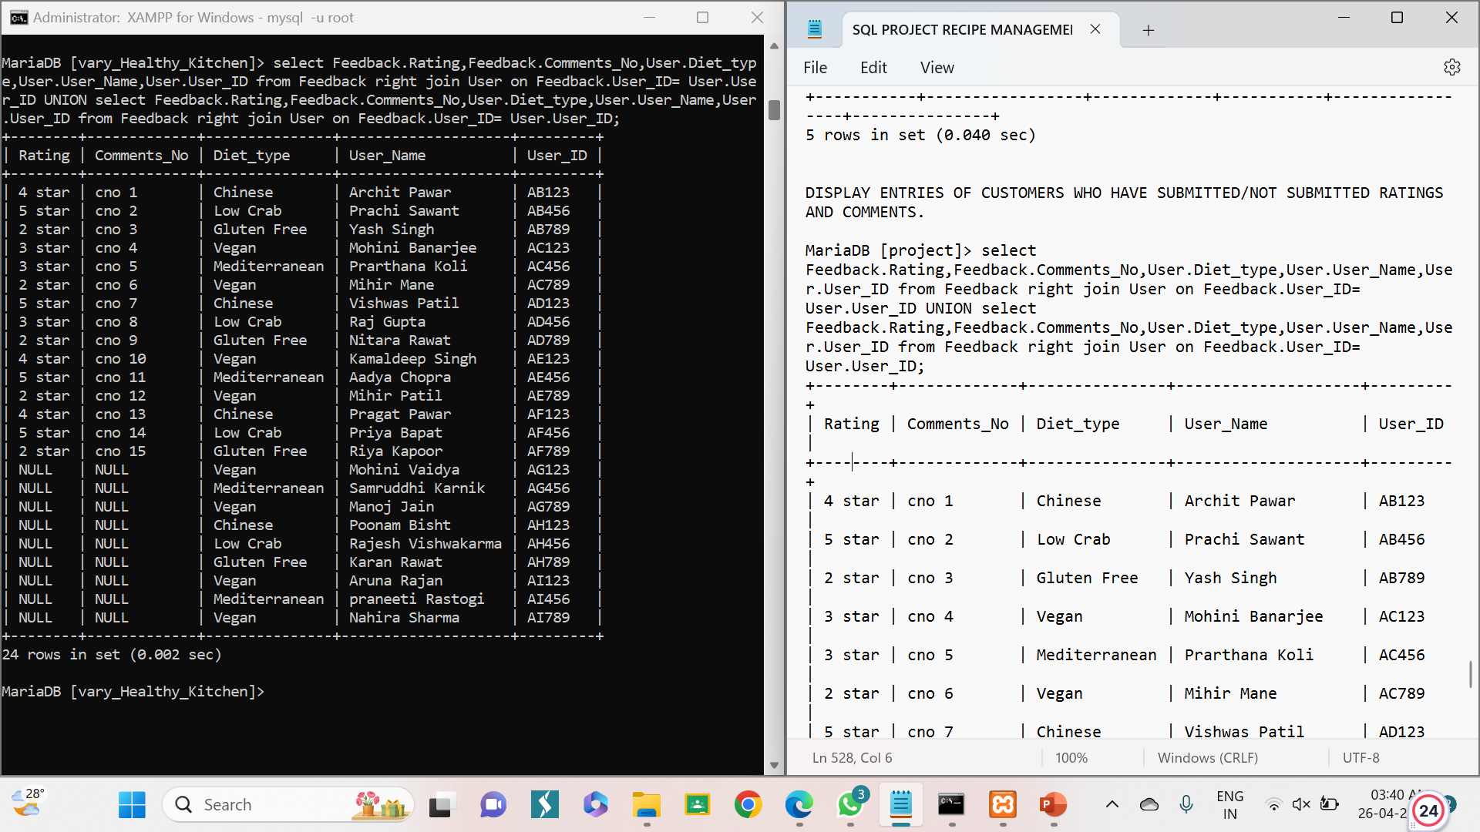
JOINS.
DISPLAY ENTRIES OF CUSTOMERS WHO HAVE SUBMITTED/NOT SUBMITTED RATINGS AND COMMENTS..
SYNTAX: select Feedback.Rating,Feedback.Comments_No,User.Diet_type,User.User_Name,User.User_ID from Feedback right join User on Feedback.User_ID= User.User_ID UNION select Feedback.Rating,Feedback.Comments_No,User.Diet_type,User.User_Name,User.User_ID from Feedback right join User on Feedback.User_ID= User.User_ID;

Slide 27
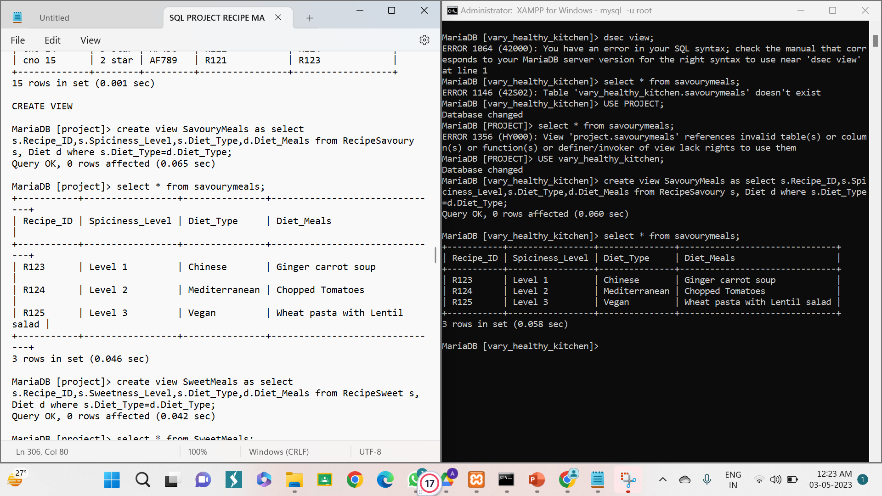
VIEWS.
CREATE VIEW AS SAVOURY MEALS.
SYNTAX: create view SavouryMeals as select s.Recipe_ID,s.Spiciness_Level,s.Diet_Type,d.Diet_Meals from RecipeSavoury s, Diet d where s.Diet_Type=d.Diet_Type;

Slide 28
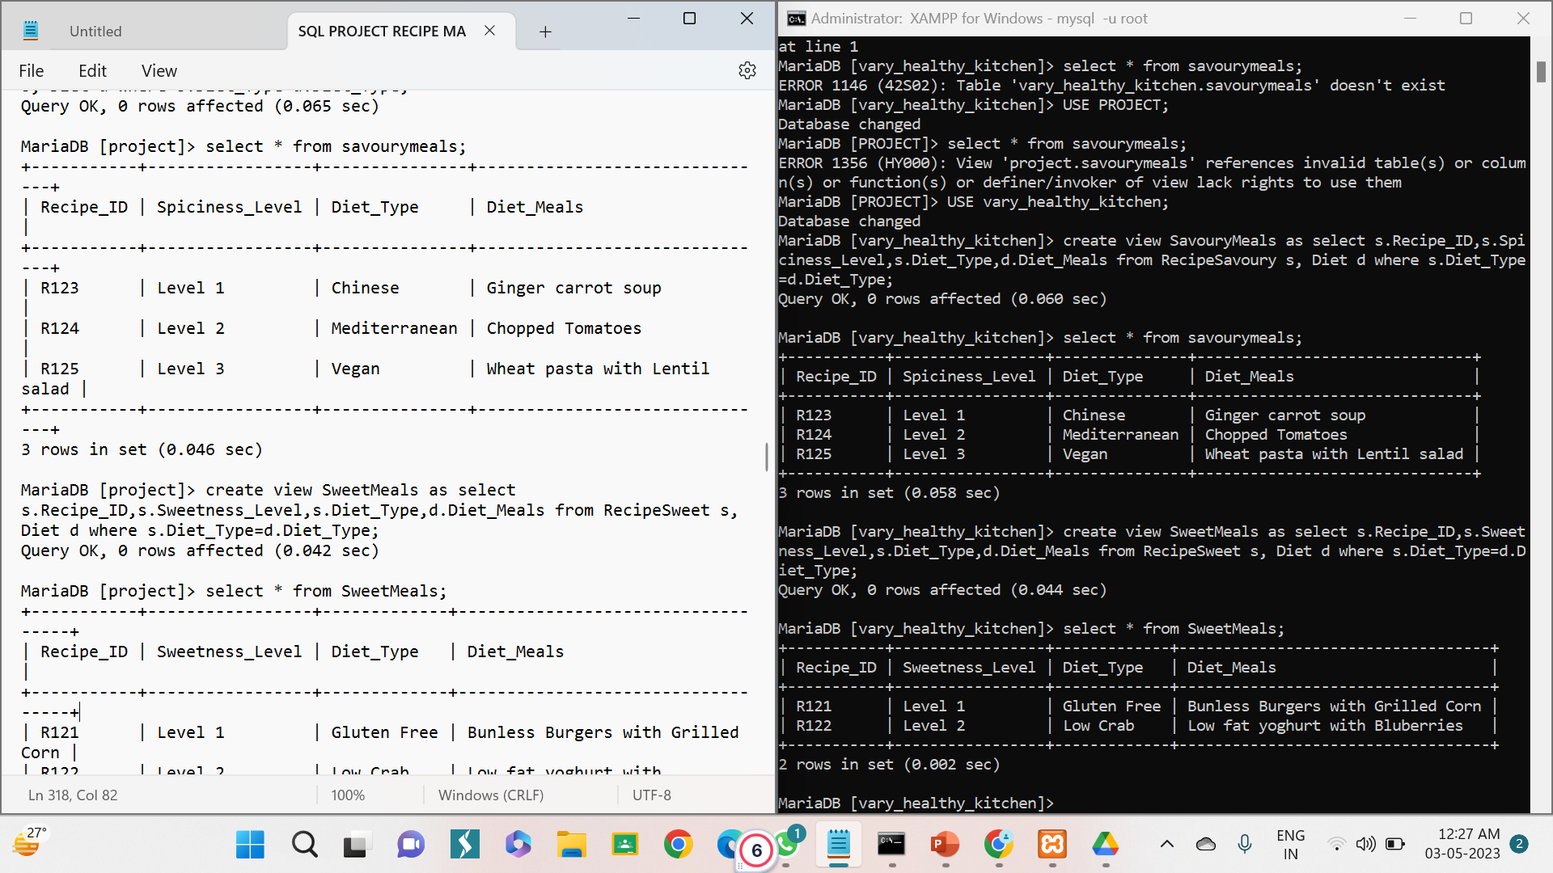
VIEWS.
CREATE VIEW AS SWEET MEALS.
SYNTAX: create view SweetMeals as select s.Recipe_ID,s.Sweetness_Level,s.Diet_Type,d.Diet_Meals from RecipeSweet s, Diet d where s.Diet_Type=d.Diet_Type;

Slide 29
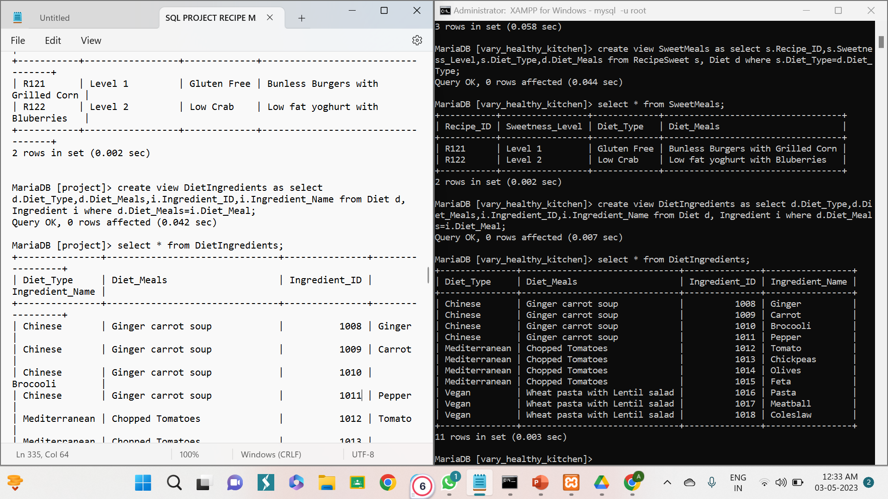
VIEWS.
CREATE VIEW AS DIET INGREDIENTS.
SYNTAX: create view DietIngredients as select d.Diet_Type,d.Diet_Meals,i.Ingredient_ID,i.Ingredient_Name from Diet d, Ingredient i where d.Diet_Meals=i.Diet_Meal;

Slide 30
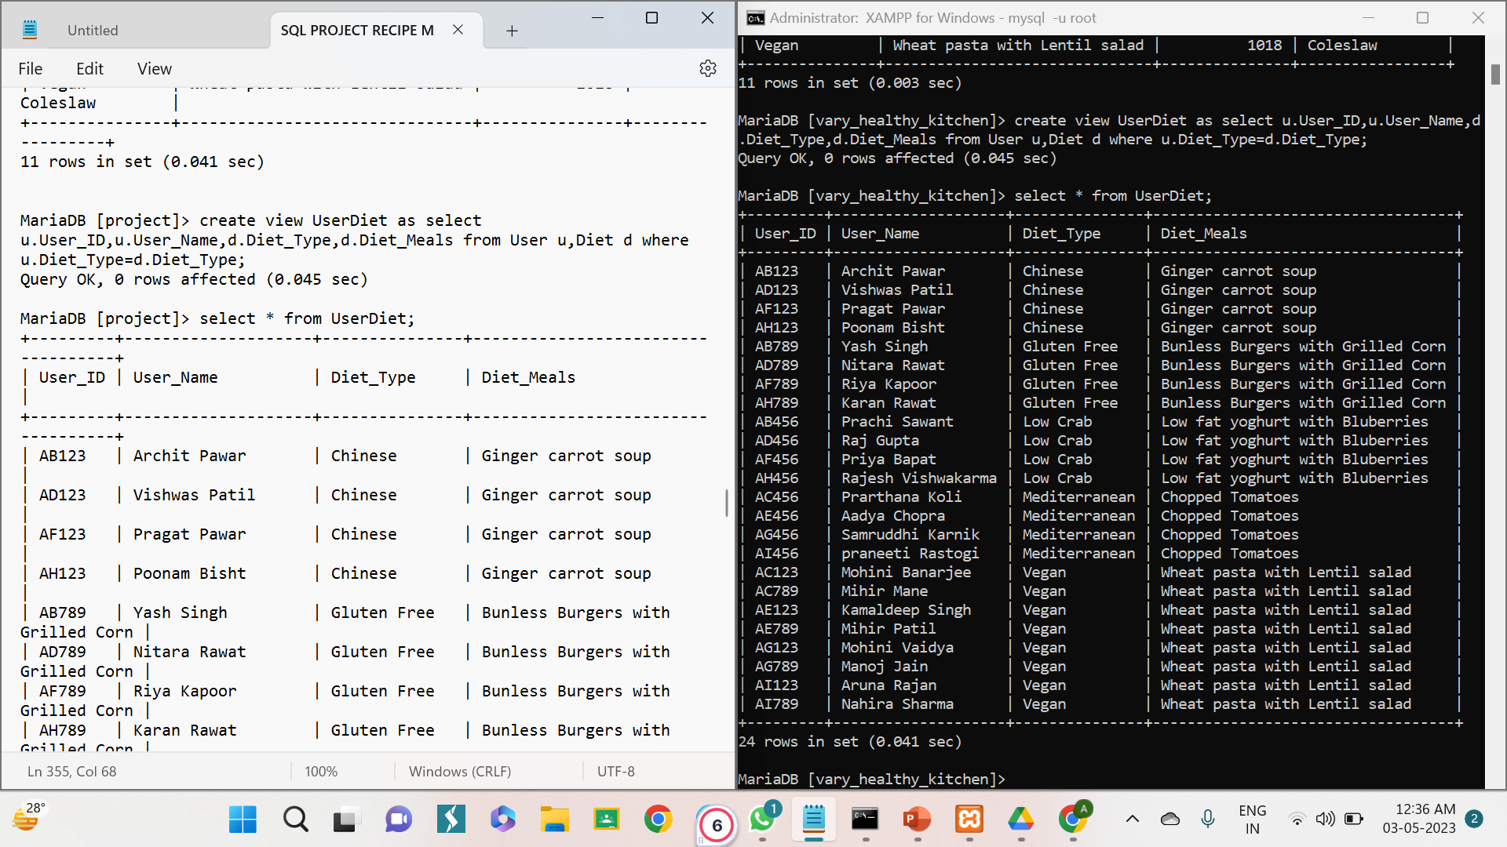
VIEWS.
CREATE VIEW AS USER DIET.
SYNTAX: create view UserDiet as select u.User_ID,u.User_Name,d.Diet_Type,d.Diet_Meals from User u,Diet d where u.Diet_Type=d.Diet_Type;

Slide 31
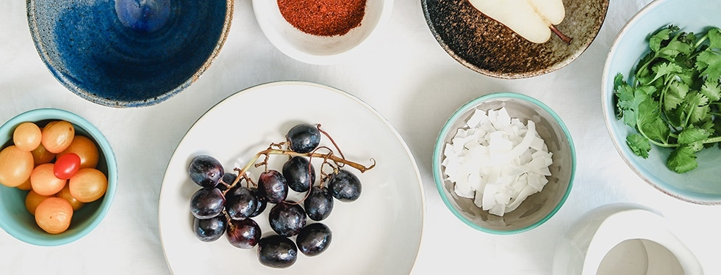

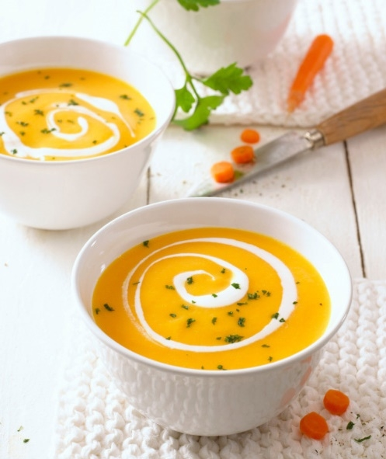
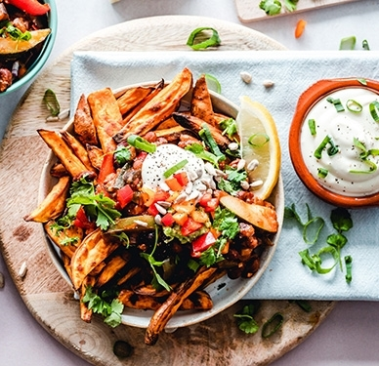
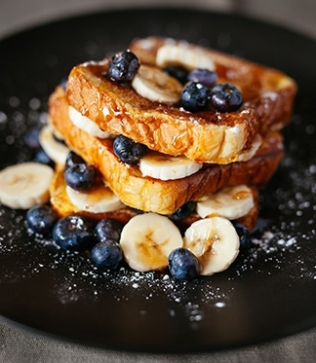
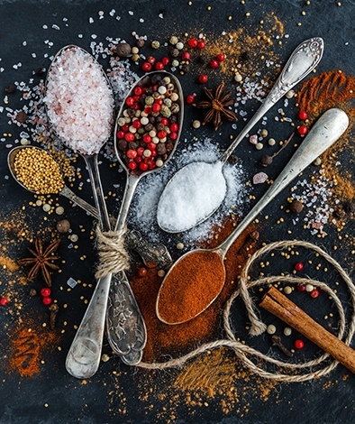
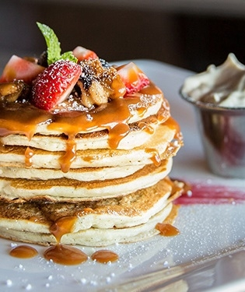
THANK YOU

